Slide 1
The Augmented Reality of
Model Counting
Willem Visser
Stellenbosch University

Slide 2
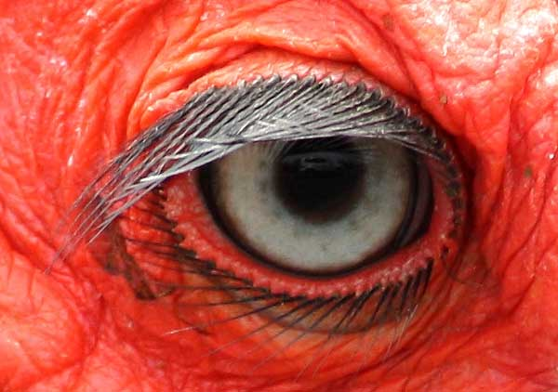
New Perspectives
on old problems

Slide 3

In a perfect world…
only linear integer constraints
and only uniform distributions

Slide 4
Symbolic Execution
void test(int x, int y) {
if (y == x*10)
S0;
else
S1;
if (x > 3 && y > 10)
S2;
else
S3;
}
[ true ] test (X,Y)
[ Y=X*10 ] S0
[ Y!=X*10 ] S1
[ X>3 & 10<Y=X*10] S2
[ X>3 & 10<Y!=X*10] S2
[ Y=X*10 & !(X>3 & Y>10) ] S3
[ Y!=X*10 & !(X>3 & Y>10) ] S3
Test(1,10) reaches S0,S3
Test(0,1) reaches S1,S3
Test(4,11) reaches S1,S2

Slide 5


Slide 6
Almost Rivers
void test(int x, int y: 0..99) {
if (y == x*10)
S0;
else
S1;
if (x > 3 && y > 10)
S2;
else
S3;
}
[ true ]
y=10x
[ Y=X*10 ]
[ Y!=X*10 ]
x>3 & y>10
x>3 & y>10
Which of 1, 2, 3 or 4 is the most likely?
1
2
3
4
[ X>3 & 10<Y=X*10]
[ Y=X*10 & !(X>3 & Y>10) ]
[ X>3 & 10<Y!=X*10]
[ Y!=X*10 & !(X>3 & Y>10) ]

Slide 7
Rivers
void test(int x, int y: 0..99) {
if (y == x*10)
S0;
else
S1;
if (x > 3 && y > 10)
S2;
else
S3;
}
[ true ]
y=10x
[ Y=X*10 ]
[ Y!=X*10 ]
x>3 & y>10
x>3 & y>10
[ X>3 & 10<Y=X*10]
[ Y=X*10 & !(X>3 & Y>10) ]
[ X>3 & 10<Y!=X*10]
[ Y!=X*10 & !(X>3 & Y>10) ]

Slide 8
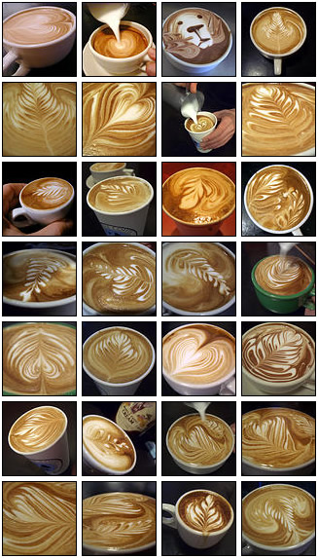
LattE Model Counter
http://www.math.ucdavis.edu/~latte/
Count solutions for
conjunction
of Linear Inequalities

Slide 9
Rivers of Values
void test(int x, int y: 0..99) {
if (y == x*10)
S0;
else
S1;
if (x > 3 && y > 10)
S2;
else
S3;
}
10⁴
[ true ]
y=10x
[ Y=X*10 ]
[ Y!=X*10 ]
10
9990
x>3 & y>10
x>3 & y>10
8538
1452
6
4
[ X>3 & 10<Y=X*10]
[ Y=X*10 & !(X>3 & Y>10) ]
[ X>3 & 10<Y!=X*10]
[ Y!=X*10 & !(X>3 & Y>10) ]

Slide 10

10⁴
[ true ]
y=10x
[ Y!=X*10 ]
Program Understanding
9990
10
[ Y=X*10 ]
x>3 & y>10
x>3 & y>10
8538
1452
6
4
[ X>3 & 10<Y=X*10]
[ Y=X*10 & !(X>3 & Y>10) ]
[ X>3 & 10<Y!=X*10]
[ Y!=X*10 & !(X>3 & Y>10) ]

Slide 11

1
y=10x
0.001
0.999
Probabilities
x>3 & y>10
x>3 & y>10
0.855
0.145
0.6
0.4
0.0004
0.8538
0.1452
0.0006
[ X>3 & 10<Y=X*10]
[ Y=X*10 & !(X>3 & Y>10) ]
[ X>3 & 10<Y!=X*10]
[ Y!=X*10 & !(X>3 & Y>10) ]

Slide 12

1
y=10x
Reliability
0.001
0.999
x>3 & y>10
x>3 & y>10
0.9996 Reliable
0.855
0.145
0.6
0.4
0.0004
0.8538
0.1452
0.0006
[ X>3 & 10<Y=X*10]
[ Y=X*10 & !(X>3 & Y>10) ]
[ X>3 & 10<Y!=X*10]
[ Y!=X*10 & !(X>3 & Y>10) ]

Slide 13
Coverage Revisited
The goal of coverage is to
measure the quality of a test suite
or
When can I stop testing?
but what you really want
is the likelihood of there
being any errors left
when you stop testing

Slide 14
Input Coverage
How many of the inputs
have been covered
Use model counting on
input partitions
Symbolic execution gives you
the input partitions

Slide 15
Input Coverage Method
Run the test suite and collect
all the symbolic input partitions
i.e. all the path conditions
Count the solutions for these
Divide by the input domain size
to obtain coverage %

Slide 16
public static int classify(int i, int j, int k) {
if ((i <= 0) || (j <= 0) || (k <= 0))
return 4;
int type = 0;
if (i == j) type = type + 1;
if (i == k) type = type + 2;
if (j == k) type = type + 3;
if (type == 0) {
// Confirm it is a legal triangle before declaring it to be scalene.
if ((i + j <= k) || (j + k <= i) || (i + k <= j)) type = 4;
else type = 1;
return type;
}
// Confirm it is a legal triangle before declaring it to be isosceles or
// equilateral.
if (type > 3) type = 3;
else if ((type == 1) && (i + j > k)) type = 2;
else if ((type == 2) && (i + k > j)) type = 2;
else if ((type == 3) && (j + k > i)) type = 2;
else type = 4;
return type;
}
DeMillo/Offutt
Triangle Classification

Slide 17
All Partitions with sizes
463344 (k+i>j)&&((k+j)>i)&&(j+i)>k)&&(j!=k)&&(i!=k)&&(i!=j)&&(k>0)&&(j>0)&&(i>0)
159250 (k+i<=j)&&(k+j>i)&&(j+i>k)&&(j!=k)&&(i!=k)&&(i!=j)&&(k>0)&&(j>0)&&(i>0)
159250 (k+j<=i)&&(j+i>k)&&(j!=k)&&(i!=k)&&(i!=j)&&(k>0)&&(j>0)&&(i>0)
159250 (j+i<=k)&&(j!=k)&&(i!=k)&&(i!=j)&&(k>0)&&(j>0)&&(i>0)
10000 (i<=0)
9900 (j<=0)&&(i>0)
9801 (k<=0)&&(j>0)&&(i>0)
7252 (k+j>i)&&(j==k))&&(i!=k)&&(i!=j)&&(k>0)&&(j>0)&&(i>0)
7252 (j+i>k)&&(i!=k)&&(i==j)&&(k>0)&&(j>0)&&(i>0)
7252 (k+i>j)&&(i==k)&&(i!=j)&&(k>0)&&(j>0)&&(i>0)
2450 (k+j<=i)&&(j==k)&&(i!=k)&&(i!=j)&&(k>0)&&(j>0))&&(i>0)
2450 (j+i<=k)&&(i!=k))&&(i==j)&&(k>0)&&(j>0)&&(i>0)
2450 (k+i<=j)&&(i==k)&&(i!=j)&&(k>0)&&(j>0)&&(i>0)
99 (i==k)&&(i==j)&&(k>0)&&(j>0)&&(i>0)
1000000 Domain

Slide 18
Random Testing Revisited
Samples | Branch Coverage | Input Coverage
1 | 24% | 46% 468146
10 | 35% | 77% 159250+468146+159250
10 | 41% | 94% 159250+468146+159250+159250
1000 | 94% | 99% -99

Slide 19
“On the Efficiency of Automated Testing”
@ FSE 2014 by Bohme and Paul
If your goal is high input coverage you cannot
beat random test generation
Unless you have an impossibly fast clever technique
Which we don’t
But what if we are looking for errors
and
those errors are rare

Slide 20
Example with loops: Buggy Binary Tree
//Domains: opt 1,2,3,4: 1..2; val 1,2,3,4: 0..9
public static void driver(
int opt1, int opt2, int opt3, int opt4,
int val1, int val2, int val3, int val4) {
BinTree b = new BinTree();
if (opt1 == 1) b.add(val1);
else b.remove(val1);
if (opt2 == 1) b.add(val2);
else b.remove(val2);
…
assert !b.checkTree() : " tree broken ”;
}

Slide 21
Random Testing for Binary Tree
Samples | Branch Coverage | Input Coverage
100 | 100% | 48%
200 | 100% | 53%
500 | 100% | 70%
1000 | 100% | 82%
2 paths out of 432 leads to the bug and
each has a size of 120, i.e. 240/160000 (.15%)

Slide 22
In this example:
Branch Coverage too easy to obtain
Error has relatively low probability
Are we wasting our time studying
the fault finding capability
of a coverage-adequate test suite?
I think we are,
the probability of behaviors is the real link

Slide 23

Mutations

Slide 24
Triangle Classification
2 Correct versions
2 Buggy versions
  One created ourselves accidentally
    Small typo >= instead of <=
  One from a student coding exercise
    Missed one condition

Slide 25
public static int classify(int i, int j, int k) {
if ((i <= 0) || (j <= 0) || (k <= 0))
return 4;
int type = 0;
if (i == j) type = type + 1;
if (i == k) type = type + 2;
if (j == k) type = type + 3;
if (type == 0) {
// Confirm it is a legal triangle before declaring it to be scalene.
if ((i + j <= k) || (j + k <= i) || (i + k <= j)) type = 4;
else type = 1;
return type;
}
// Confirm it is a legal triangle before declaring it to be isosceles or
// equilateral.
if (type > 3) type = 3;
else if ((type == 1) && (i + j > k)) type = 2;
else if ((type == 2) && (i + k > j)) type = 2;
else if ((type == 3) && (j + k > i)) type = 2;
else type = 4;
return type;
}
Correct1

Slide 26
public static int classify(int i, int j, int k) {
if ((i <= 0) || (j <= 0) || (k <= 0))
return 4;
int type = 0;
if (i == j) type = type + 1;
if (i == k) type = type + 2;
if (j == k) type = type + 3;
if (type == 0) {
// Confirm it is a legal triangle before declaring it to be scalene.
if ((i + j <= k) || (j + k <= i) || (i + k >= j)) type = 4;
else type = 1;
return type;
}
// Confirm it is a legal triangle before declaring it to be isosceles or
// equilateral.
if (type > 3) type = 3;
else if ((type == 1) && (i + j > k)) type = 2;
else if ((type == 2) && (i + k > j)) type = 2;
else if ((type == 3) && (j + k > i)) type = 2;
else type = 4;
return type;
}
Buggy1

Slide 27
Correct2
public static int classify(int a, int b, int c) {
if (a <= 0 || b <= 0 || c <= 0)
return 4;
if (! (a > c - b && a > b - c && b > a - c))
return 4;
if (a == b && b == c)
return 3;
if (a == b || b == c || a == c)
return 2;
return 1;
}

Slide 28
Buggy2
public static int classify(int a, int b, int c) {
if ((a <= 0) || (b <= 0) || (c <= 0))
return 4;
if ((a <= c - b) || (a<= b - c) || (b<= a - c))
return 4;
if (a == b && b == c)
return 3;
if (((a == b) && (b != c)) ||
((a == c) && (a != b) && ((b == c) && (b != a))))
return 2;
return 1;
}

Slide 29
Which of Correct1 or Correct2 is the “best”?
public static int classify(int i, int j, int k) {
if ((i <= 0) || (j <= 0) || (k <= 0))
return 4;
int type = 0;
if (i == j) type = type + 1;
if (i == k) type = type + 2;
if (j == k) type = type + 3;
if (type == 0) {
if ((i + j <= k) || (j + k <= i) || (i + k <= j))
type = 4;
else type = 1;
return type;
}
if (type > 3) type = 3;
else if ((type == 1) && (i + j > k)) type = 2;
else if ((type == 2) && (i + k > j)) type = 2;
else if ((type == 3) && (j + k > i)) type = 2;
else type = 4;
return type;
}
public static int classify(int a, int b, int c) {
if (a <= 0 || b <= 0 || c <= 0)
return 4;
if (! (a > c - b && a > b - c && b > a - c))
return 4;
if (a == b && b == c)
return 3;
if (a == b || b == c || a == c)
return 2;
return 1;
}

Slide 30
Correct1 All Partitions with sizes
463344 (k+i>j)&&((k+j)>i)&&(j+i)>k)&&(j!=k)&&(i!=k)&&(i!=j)&&(k>0)&&(j>0)&&(i>0)
159250 (k+i<=j)&&(k+j>i)&&(j+i>k)&&(j!=k)&&(i!=k)&&(i!=j)&&(k>0)&&(j>0)&&(i>0)
159250 (k+j<=i)&&(j+i>k)&&(j!=k)&&(i!=k)&&(i!=j)&&(k>0)&&(j>0)&&(i>0)
159250 (j+i<=k)&&(j!=k)&&(i!=k)&&(i!=j)&&(k>0)&&(j>0)&&(i>0)
10000 (i<=0)
9900 (j<=0)&&(i>0)
9801 (k<=0)&&(j>0)&&(i>0)
7252 (k+j>i)&&(j==k))&&(i!=k)&&(i!=j)&&(k>0)&&(j>0)&&(i>0)
7252 (j+i>k)&&(i!=k)&&(i==j)&&(k>0)&&(j>0)&&(i>0)
7252 (k+i>j)&&(i==k)&&(i!=j)&&(k>0)&&(j>0)&&(i>0)
2450 (k+j<=i)&&(j==k)&&(i!=k)&&(i!=j)&&(k>0)&&(j>0))&&(i>0)
2450 (j+i<=k)&&(i!=k))&&(i==j)&&(k>0)&&(j>0)&&(i>0)
2450 (k+i<=j)&&(i==k)&&(i!=j)&&(k>0)&&(j>0)&&(i>0)
99 (i==k)&&(i==j)&&(k>0)&&(j>0)&&(i>0)

Slide 31
Correct2 All Partitions with sizes
463344 (a!=c)&&(b!=c)&&a!=b&&b>a-c&&(a>(b-c)&&(a>(c-b)&&(c>0)&&(b>0)&&(a>0)
161700 b<=(a-c))&&(a>(b-c)))&&(a>(c-b)))&&(c>0))&&(b>0))&&(a>0)
161700 (a<=(b-c))&&(a>(c-b)))&&(c>0))&&(b>0))&&(a>0)
161700 (((a<=(c-b))&&(c>0))&&(b>0))&&(a>0)
10000 (a<=0)
9900 (b<=0)&&(a>0)
9801 (c<=0)&&(b>0)&&(a>0)
7252 a==c&&(b!=c)&&(a!=b))&&b>a-c&&a>b-c&&a>c-b&&c>0&&b>0&&(a>0)
7252 b!=c&&a==b&&(b>(a-c)))&&(a>(b-c)))&&(a>(c-b)))&&(c>0))&&(b>0))&&(a>0)
7252 b==c&&a!=b&&(b>(a-c)))&&(a>(b-c)))&&(a>(c-b)))&&(c>0))&&(b>0))&&(a>0)
99 (i==k)&&(i==j)&&(k>0)&&(j>0)&&(i>0)
Correct2 is “better”
it has less paths dealing with the Illegal Triangle case

Slide 32
Test harness
public static void check(int a, int b, int c) {
int test = classifyBuggy1(a, b, c);
int oracle = classifyCorrect1(a, b, c);
assert (test == oracle);
}
Record path conditions
when assertion fails and
count their sizes

Slide 33
Counting size of failing partitions
Correct vs Buggy1
2 failing paths: 463344 and 154448
Correct vs Buggy2
2 failing paths: 7252 and 7252
Buggy2 is closer than Buggy1

Slide 34
New Insight
Mutations in programs can have bigger effect than one might think
Notice how a small <= to >= change made the program incorrect on more inputs than a logical mistake
Can we rank mutation operators according to how much of the behavior of a program they mutate?

Slide 35
Mutation Example
boolean classify1(int i, int j : 0..99) {
return i <= j;
}
1
99% wrong
2
1% wrong
boolean classify1(int i, int j) {
return i >= j;
}
boolean classify1(int i, int j) {
return i < j;
}
3
49.5% wrong
4
49.5% wrong
boolean classify1(int i, int j) {
return i == j;
}
boolean classify1(int i, int j) {
return true;
}

Slide 36
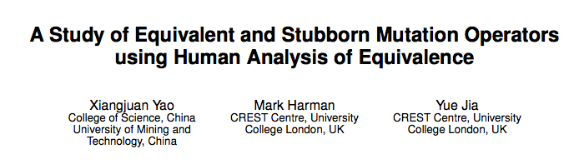
ICSE 2014
Large study with many subjects and
5 classes of mutation operators
Human/manual analysis for equivalence
Stubborn mutants are not killed by a
test suite that covers all branches

Slide 37
What we did
Large study
ABS,ROR,LOR,AOR,UOR
Human/manual analysis for equivalence
Stubborn mutants are not killed by a
test suite that covers all branches
Small study on Triangle
ROR,AOR,CONST
Precise analysis for equivalence
Stubborn mutants are ones that are statistically
hard to kill

Slide 38
More Precisely What We Did
2 Correct Versions of Triangle
Bytecode mutation
  No Logical Operators (LOR)
  All applicable mutations
    Relational (>= to == for example) DOMINATES
    Arithmetic (- to + for example)
    Constants (0 to 1 for example)
Running through SPF with model counting checking the number of inputs that show a difference in output
Equivalence is when Mutation and Oracle gives the same result for all paths (Strong Mutation)
Stubborn Mutants when less than 1% of behaviors will trigger a difference in output
Very Stubborn Mutants less than 0.1%
Dumps out a CSV file with data

Slide 39
Comparison on Triangle
24/17/168 (E/S/T)
AOR - 0/0/4
ROR – 7/3/40
  Should be 6/3/40
E/S1%/S.1%/T
Version 1
  6/42/7/103
  AOR – 0/3/0/6
  ROR – 5/30/6/84
  CONST – 1/9/1/13
Version 2
  5/14/1/62
  AOR – 0/0/0/3
  ROR – 5/13/0/54
  CONST – 0/1/1/5
Version 3
  6/8/0/44
  AOR – 0/0/0/1
  ROR – 6/7/0/39
  CONST – 0/1/0/4

Slide 40
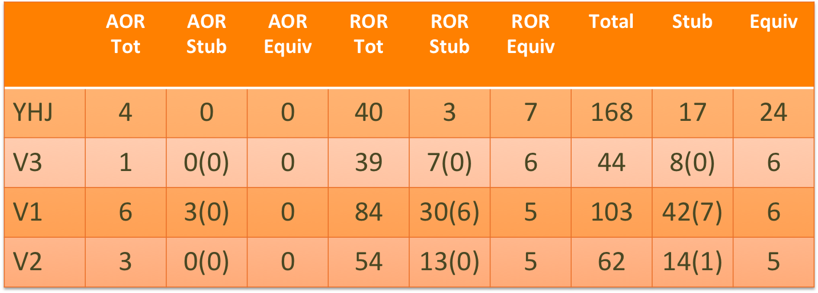
Triangle Results

Slide 41
Goals and Outcomes of YHJ2014
Wanted to rank mutation operators according to how many equivalent and stubborn mutants they create
We had the same goal
They found for the ROR class you get stubborn and equivalent mutants in almost equal amounts (other classes had no such connection)
They also found that more mutations implied more equivalent mutations, but no such correlation with stubbornness

Slide 42
What did we find?
public static int classify(int i, int j, int k) {
if ((i <= 0) || (j <= 0) || (k <= 0))
return 4;
int type = 0;
if (i == j) type = type + 1;
if (i == k) type = type + 2;
if (j == k) type = type + 3;
if (type == 0) {
if ((i + j <= k) || (j + k <= i) || (i + k <= j)) type = 4;
else type = 1;
return type;
}
if (type > 3) type = 3;
else if ((type == 1) && (i + j > k)) type = 2;
else if ((type == 2) && (i + k > j)) type = 2;
else if ((type == 3) && (j + k > i)) type = 2;
else type = 4;
return type;
}
Stubborn Barrier
Almost all Mutations
are Stubborn (<1%)

Slide 43
Why?
public static int classify(int i, int j, int k) {
if ((i <= 0) || (j <= 0) || (k <= 0))
return 4;
int type = 0;
if (i == j) type = type + 1;
if (i == k) type = type + 2;
if (j == k) type = type + 3;
if (type == 0) {
if ((i + j <= k) || (j + k <= i) || (i + k <= j)) type = 4;
else type = 1;
return type;
}
if (type > 3) type = 3;
else if ((type == 1) && (i + j > k)) type = 2;
else if ((type == 2) && (i + k > j)) type = 2;
else if ((type == 3) && (j + k > i)) type = 2;
else type = 4;
return type;
}
Only 3% of inputs
pass here

Slide 44
Conjecture
Stubbornness has little to do with the
mutation operator,
it is more important how many values
reach the point where
the mutation is applied.

Slide 45
Really Stubborn Mutations
Calculate how many values reach the point where the mutation is applied
Divide the values that show a difference in output by this new value
If this new probability of detecting a mutation is low then the mutation operator creates a stubborn mutant
Only some operators create really stubborn mutants
  <= mutated to < (V1,V2,V3)
  >= mutated to > (V1,V2,V3)
  != mutated to < (V2) , <= (V2,V3), > (V2)

Slide 46
Road-Kill Mutations
When controlling for the difficulty of reaching a mutations point
Some mutations become inevitable (100% killed)
  8 of the stubborn mutations after the stubborn barrier
  2 of the stubborn mutations remained
Which operators lead to inevitable mutations
  <= mutated to > (V1)
  > mutated to <= (V1,V2,V3)
  CONST mutations (V1,V2,V3)
  != mutated to == (V2,V3), >= (V3)

Slide 47
Conclusions
Model Counting can be used for many things in Program Analysis
Maybe even bring new insights into old problems
  Probability of behaviors seems fundamental to many problems
Mutations should be handled with care
  Fewer well chosen mutations
  Probably lots of mutation-based fault seeding research should be revisited

Slide 48

The Green Framework
http://green-solver.googlecode.com
Already integrated into
Symbolic PathFinder

Slide 49
Resources
ISSTA 2012
  Probabilistic Symbolic Execution
FSE 2012
  Green: Reduce, Reuse and Recycle Constraints…
ICSE 2013
  Software Reliability with Symbolic PathFinder
PLDI 2014
  Compositional Solution Space Quantification for Probabilistic Software Analysis
FSE 2014
  Statistical Symbolic Execution with Informed Sampling
ASE 2014
  Exact and Approximate Probabilistic Symbolic Execution for Nondeterministic Programs
Implemented in Symbolic PathFinder
  Using LattE

